Slide 1
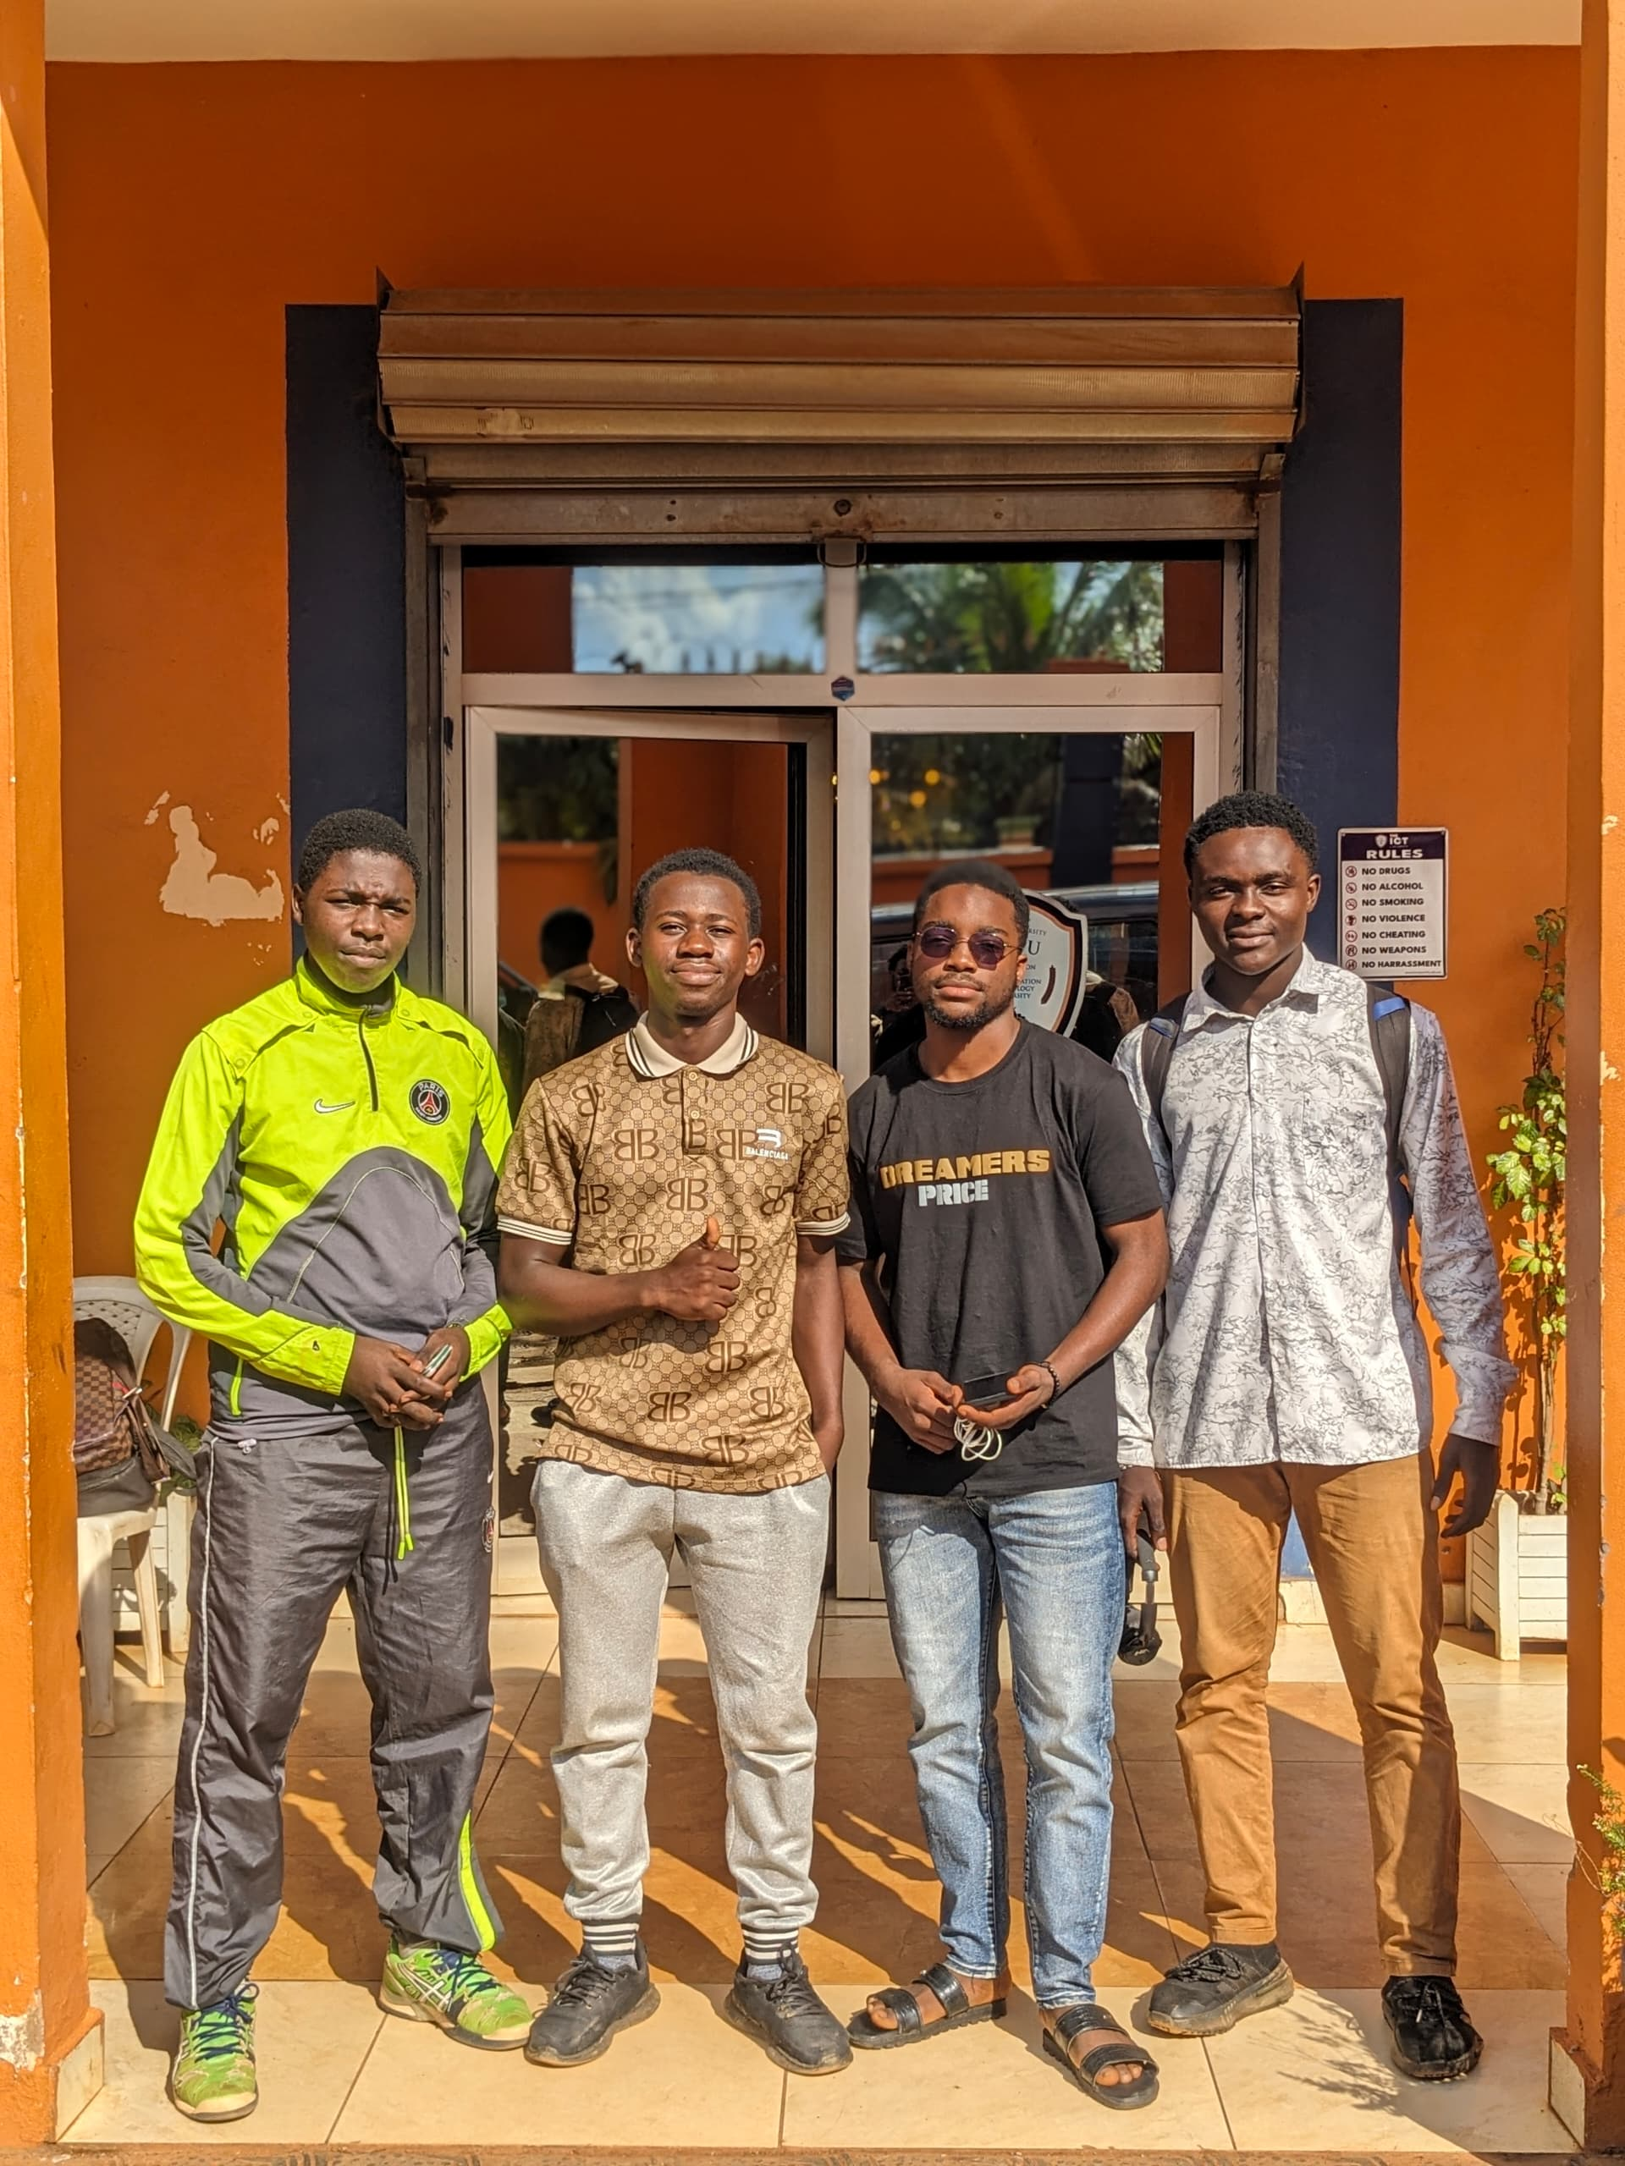
Introduction to the Hotel Management System Project
This presentation details the development of a comprehensive Hotel Management System, a collaborative project undertaken by a team of seven ICT-University students. The system aims to streamline hotel operations, enhance guest experiences, and provide valuable insights for management.

Slide 2
Team Overview
Development Team
Our team comprises seven highly motivated and skilled ICT students, each contributing their unique expertise to the project. The team members represent diverse skill sets, ensuring a well-rounded approach to the project.
Group: 4
MEMBERS
NEDJOU DESTIN TRESOR
CHOFOR SEITSOU PRIESTLEY CLARKSON
NDASSA NJOYA FILS FAYSSAL
ABDEL-KADER BILAL ALAMINE
ARREY ETTA OSAMBENGHE
MBUNA VERLAINE CLAUDE
DJIMPE JULY
Collaboration and Communication
Effective communication and collaboration have been central to our team's success. Regular meetings, open discussions, and clear task assignments facilitated seamless teamwork.
Diverse Expertise
The team encompasses a range of technical skills, including frontend development, backend engineering, database management, and deployment expertise. This diverse skill set allowed for comprehensive system development.

Slide 3

NEDJOU DESTIN TRESOR Role: Group Leader and Lead Frontend Developer "I believe in creating systems that not only function well but also elevate the user experience through design and efficiency."
Technical Expertise:
Spearheaded the development of key frontend components using React.js, ensuring smooth user experiences and responsive design across various sections of the hotel management system.
Primarily focused on the Booking, Customer, Account, and Report modules, building intuitive interfaces for administrators and users alike.
Leadership Skills:
Provided clear direction and motivation to the team, ensuring timely delivery of project milestones.
Demonstrated strong project management skills, overseeing the team's progress and coordinating between different roles, from frontend to backend developers.
Encouraged innovative thinking and problem-solving among the team members, driving the vision for a robust, user-friendly hotel management system.
Contributions:
Ensured that all frontend components were visually appealing and fully functional, reflecting the project’s key objectives of user-friendliness and efficiency.
Collaborated closely with the backend team to align the user interface with the underlying data architecture, ensuring a seamless flow between the frontend and backend.

Slide 4
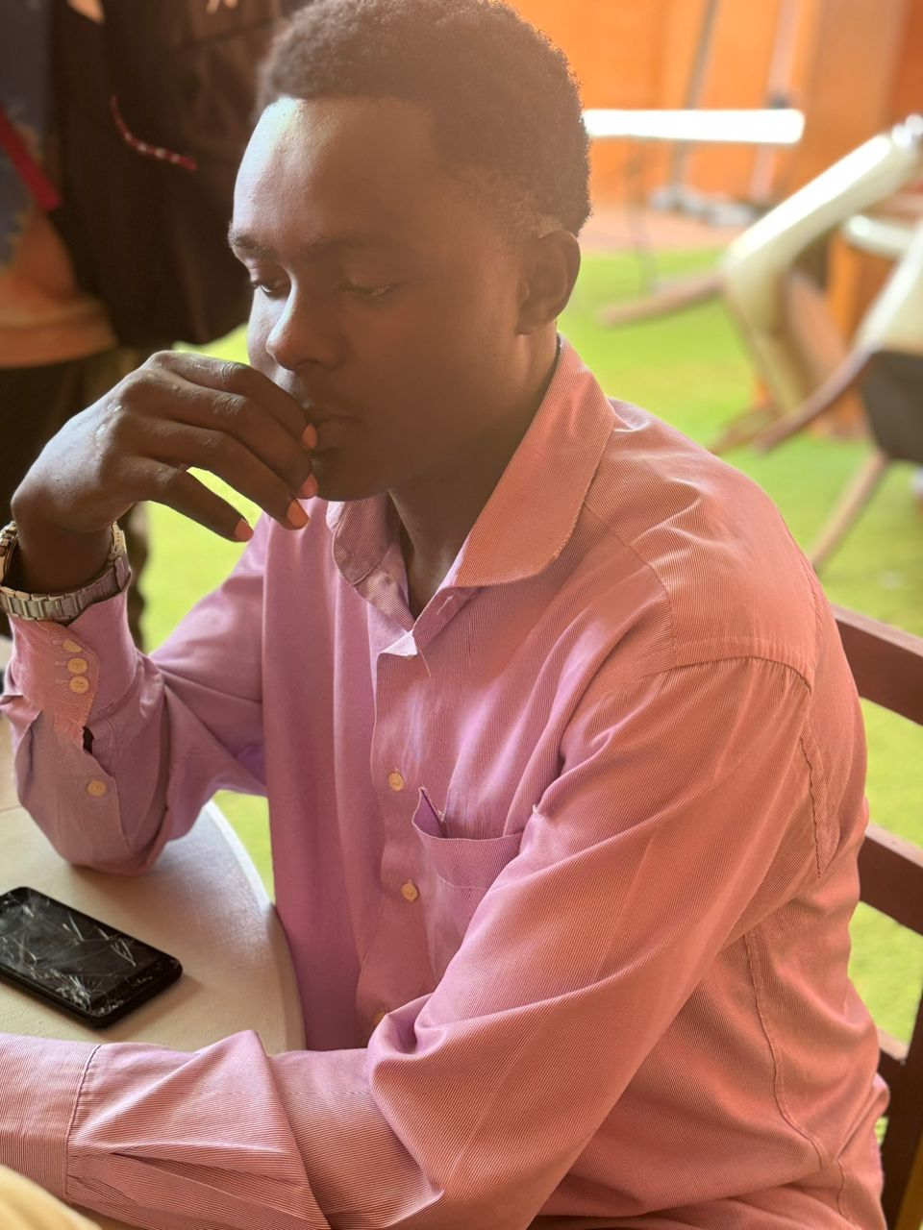
CHOFOR SEITSOU PRIESTLEY CLARKSON Role: Backend Developer and System Architect
Technical Expertise:
Played a pivotal role in designing and implementing the backend architecture using Node.js and Sanity CMS.
Engineered the entire data structure, enabling seamless interaction between the frontend and backend systems.
Focused on creating a robust, scalable, and secure API that powers the hotel management system's functionality.
Integrated Sanity CMS for flexible content management, ensuring dynamic updates to room availability, bookings, and customer data without the need for hard-coded changes.
Key Contributions:
Conceptualized the backend logic and structure, setting the foundation for the entire system's functionality.
Developed the Dashboard for administrators, providing real-time insights into bookings, payments, and hotel operations.
Leadership in Backend Development:
Provided the team with clear guidelines on how the frontend should communicate with the backend, ensuring consistency in the data flow.
Collaborated with the group leader and frontend developers to make sure the backend was fully aligned with the project’s overall objectives.
"My goal was to build a backend system that is not only functional but also flexible enough to adapt to future growth and changes."

Slide 5

Ndassa Njoya Fils Fayssal Role: Frontend Developer "My focus was to make staff management intuitive and efficient for administrators, ensuring the system meets the needs of the hotel staff effortlessly."
Technical Expertise:
Took charge of the development of the Staff Management section of the hotel management system, ensuring that all functionalities related to employee management were implemented with precision.
Ensured that the Staff Frontend section was visually aligned with the overall design of the application, following modern UI/UX practices.
Key Contributions:
Developed the Staff Management module, making it easy for the hotel to track employee information, manage roles, and monitor attendance.
Worked on ensuring that the staff data could be updated, added, or deleted seamlessly, with real-time data rendering.
Contributed to the Web Application Report, helping gather and present detailed information on the functionality and performance of the system's frontend.
Collaboration:
Worked closely with both the backend team and other frontend developers to ensure smooth integration of data related to staff and employee management.
Focused on delivering a system that was both easy for administrators to use and robust enough to handle large amounts of employee data.

Slide 6

Abdel-kader Bilal Alamine Role: Frontend Developer
Technical Expertise:
Specializes in the development and management of the Room and Activities sections of the hotel management system.
Key Contributions:
Developed the Room Management interface, allowing for easy addition, modification, and deletion of room details. Ensured that room availability and pricing updates were reflected in real-time.
Implemented responsive design principles to ensure that both the Room and Activities sections are accessible and functional across various devices and screen sizes.
Collaboration:
Worked closely with the backend team to ensure that room and activities data were accurately integrated and displayed.
"My aim was to make managing rooms and activities as straightforward as possible, providing a smooth and engaging experience for users and staff alike."

Slide 7
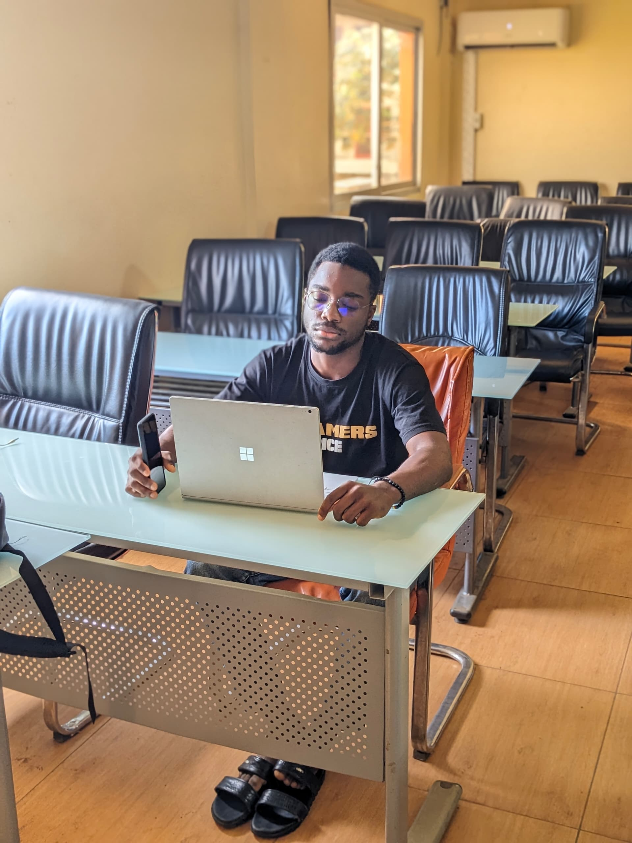
Arrey Etta Osambenghe Role: Frontend Developer
Technical Expertise:
Specialized in developing secure and user-friendly Login Pages and the Employees Section for the hotel management system.
Key Contributions:
Designed and implemented all Login Pages, ensuring a smooth user experience with robust security features, including password recovery and user authentication.
Developed the Employees Section, which allows the hotel management team to easily manage staff information, attendance, and other employee-related tasks.
Integrated modern design principles to ensure consistency across the system’s user interfaces.
Collaboration:
Worked closely with backend developers to synchronize login data with the backend, ensuring secure and efficient user management.
Coordinated with other frontend developers to ensure the design and functionality of the Login Pages and Employees Section fit seamlessly into the broader system.

Slide 8

Mbuna Verlaine Claude Role: Frontend Developer
Technical Expertise:
Specialized in creating visually appealing and user-friendly interfaces for the hotel management system.
Focused on the design and development of the Pricing Frontend, ensuring that pricing information is presented clearly and effectively to users.
Key Contributions:
Designed and implemented the Pricing Frontend, providing an intuitive interface for managing and displaying room rates, special offers, and pricing details.
Created the sequence diagram for the project, mapping out the flow of interactions between the system’s components, which helped streamline the development process and improve team collaboration.
Collaboration:
Worked closely with other frontend developers to ensure design consistency across the application.
diagram, which visually mapped the interaction between system components, aiding in efficient development and project clarity.

Slide 9

Djimpe July Role: Frontend Developer
Technical Expertise:
Focused on the design and development of the Calendar Form for the hotel management system, which manages daily activities throughout the year.
Key Contributions:
Developed a dynamic Calendar Form to handle the scheduling of activities, reservations, and events for each day of the year.
Integrated the calendar into the hotel management system, allowing users to view, add, and manage activities in a visually organized and efficient manner.
Collaboration:
Coordinated with the backend team to ensure real-time synchronization of events and schedules.
"My goal was to create a comprehensive and user-friendly calendar system that helps streamline the management of daily activities and events for the hotel."

Slide 10
Project Overview
Scope
The system encompasses various hotel functionalities, including booking management, room assignment, user authentication, payment integration, and security measures. This comprehensive approach aims to streamline overall hotel operations.
Objective
To create a robust and user-friendly Hotel Management System that automates key process
System Overview
The system features a user-friendly interface for both guests and hotel staff, enabling seamless interaction with the system. Additionally, it leverages a secure backend infrastructure for robust data management and processing.

Slide 11

Technology Stack

Slide 12

Frontend (React.js) React.js is a JavaScript library used to build the user interface, creating a dynamic and responsive experience for both guests and hotel staff.

Slide 13

Backend (Node.js) Node.js powers the server-side logic and API development, handling data processing, user authentication, and secure communication between the frontend and backend.

Slide 14

Content Management (Sanity) Sanity is used as a headless CMS to manage and organize hotel data, including room information, pricing, amenities, and other essential content. It enables content updates and management without requiring code changes. Deployment (Vercel) Vercel provides a seamless platform for continuous deployment, ensuring that the system is constantly updated and accessible to users. It simplifies the deployment process and ensures optimal system performance.

Slide 15

Frontend (React.js) User Interface Design A visually appealing and intuitive user interface has been designed using React.js. The interface is optimized for both desktop and mobile devices, offering a seamless experience across all platforms. Responsive Design The frontend design is responsive and adapts to different screen sizes, ensuring a consistent user experience on desktops, tablets, and smartphones. Accessibility Features Accessibility was considered during frontend development, ensuring that the system is usable for individuals with disabilities. This includes features like screen reader compatibility and keyboard navigation.

Slide 16
Database and Data Structure
Data Category | Example Fields
Room Information | Room Type, Capacity, Amenities, Pricing, Availability
Guest Information | Name, Contact Details, Booking History
Booking Details | Arrival Date, Departure Date, Room Type, Guest Information, Payment Information
Staff Information | Name, Role, Contact Details, Login Credentials

Slide 17

Conclusion The Hotel Management System project has successfully created a comprehensive and user-friendly system that streamlines hotel operations, enhances guest experiences, and empowers management with valuable insights. Future enhancements will focus on expanding functionality, integrating with additional services, and incorporating cutting-edge technologies.

